Slide 1
7 Habits of Highly Effective People
By Stephen Covey

Slide 2
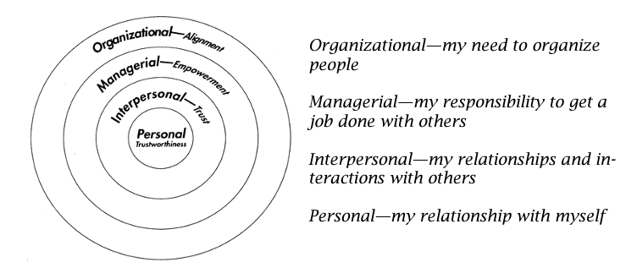
4 Roles of Leadership
Increased
Influence
The 7 Habits Focus Here

Slide 3
Developing Habits
Knowledge
(why?, what?)
Skill
(how?)
Desire
(want)
A habit is defined as an intersection of knowledge, skill, and desire.
Knowledge is understanding what to do and why to do it; skill is knowing how to do it; desire is motivation or wanting to do it.
To make habits, we need to develop all three components.
Habits
“People don't decide their future. They decide their habits, and their habits decide their futures.” - F.M. Alexander
Notes:
A habit is defined as an intersection of knowledge, skill, and desire. Knowledge is understanding what to do and why to do it; skill is knowing how to do it; desire is motivation or wanting to do it. To make habits, we need to develop all three components.

Slide 4
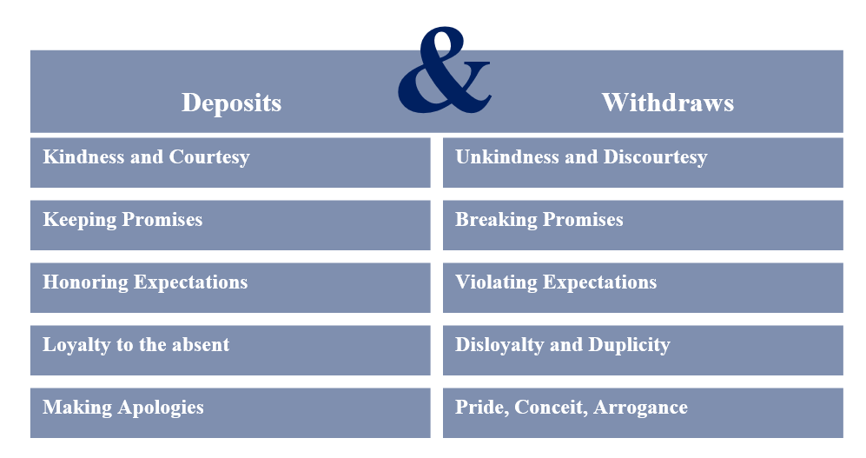
Emotional Bank Account
The EBA is a metaphor for the trust that exists in a relationship. It suggests that every interaction with another person may be classified as a deposit or withdrawal. Deposits build and repair trust in relationships. Withdrawals lessen trust in relationships.

Slide 5
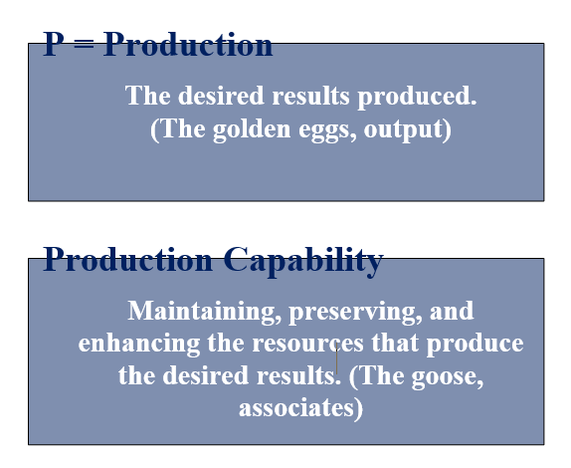
P/PC Balance
The production can be pieces of the assembly line, health, energy, happiness, etc.
Production Capability can be associates, equipment, supplier relations, community relations, etc.
The main idea is to take care of that which is producing what you need.

Slide 6
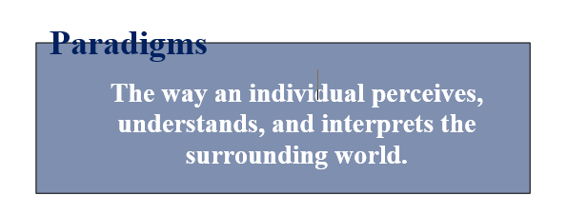
Paradigms
Paradigms can be compared to a roadmap. If your map is correct, you can get where you are going. If your map is incorrect, you are destined to get lost. Furthermore, if you have the wrong map and try to get where you are going faster, you get lost even faster.
Examples:
  Battleship

Slide 7
Potential Traps
Social Mirrors
The way we see ourselves because others reflect their perceptions, opinions, and paradigms about us through their words and behaviors.
Self-Fulfilling Prophecy
Our beliefs about ourselves and others influence our self-perception, behavior, and performance.

Slide 8
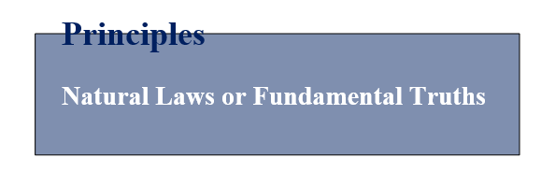
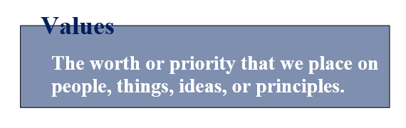
Principles vs. Values
Principles:
  Universal, timeless.
  Produce predictable outcomes.
  External to ourselves
  Operate with or without our understanding or acceptance.
  Self-Evident and enabling when understood.
Values:
  Self-chosen beliefs or ideas
  Internal, subjective, based on how we see the world.
  Influenced by upbringing, society, and personal reflection.

Slide 9

Character vs. Personality
Your appearance and the perception that you convey can bring you outward success.
However, true effectiveness comes from a grounded character.
You may put on a front, but your true character can be revealed under pressure.
Personality
Character

Slide 10
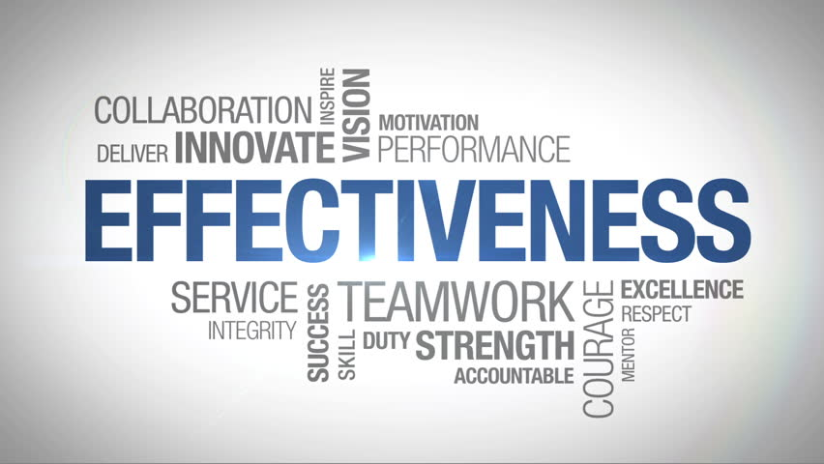
Effectiveness
Effectiveness = Doing the Right Things Right; Getting what you want and getting it in a way that you can get it repeatedly.

Slide 11
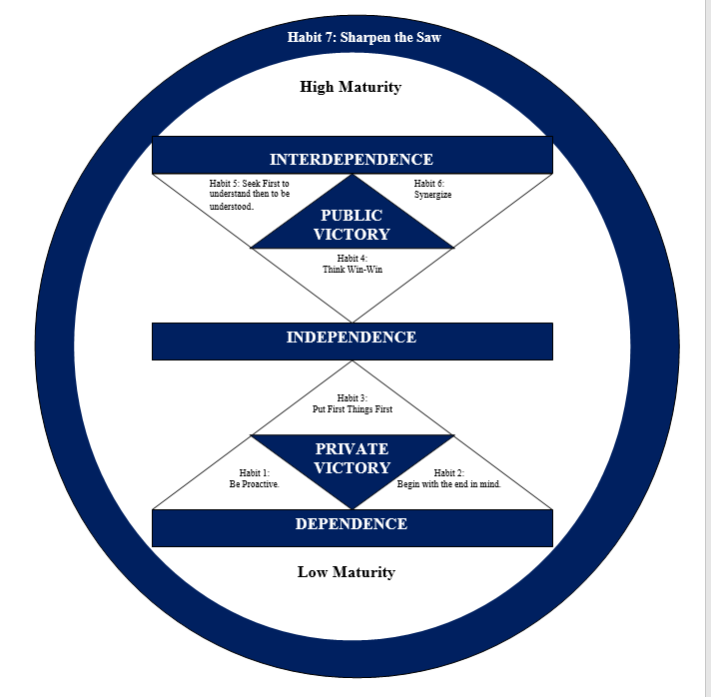
Seven Habits Continuum
You can’t have Public Victory without first having Private Victory.

Slide 12
Habit 1 – Be Proactive
Principle:
  Individuals are responsible for their own choices and have the freedom to choose.
Key Paradigms:
  “I am responsible for my behavior and my life choices.”
  “I can expand my freedom and influence by being proactive.”
Key Processes:
  Recognize your reaction tendencies and develop proactive responses.
  Increase your circle of influence.
  Become a transition figure to benefit yourself and others.
  Exercise the human endowments through conscious choice in decision-making.

Slide 13
Reaction Tendancies
Reactive people allow outside influences to control their responses.
Proactive people use the margin of Freedom to Choose to apply their values before responding.
Stimulus
Freedom to choose
Response
Stimulus
Response

Slide 14
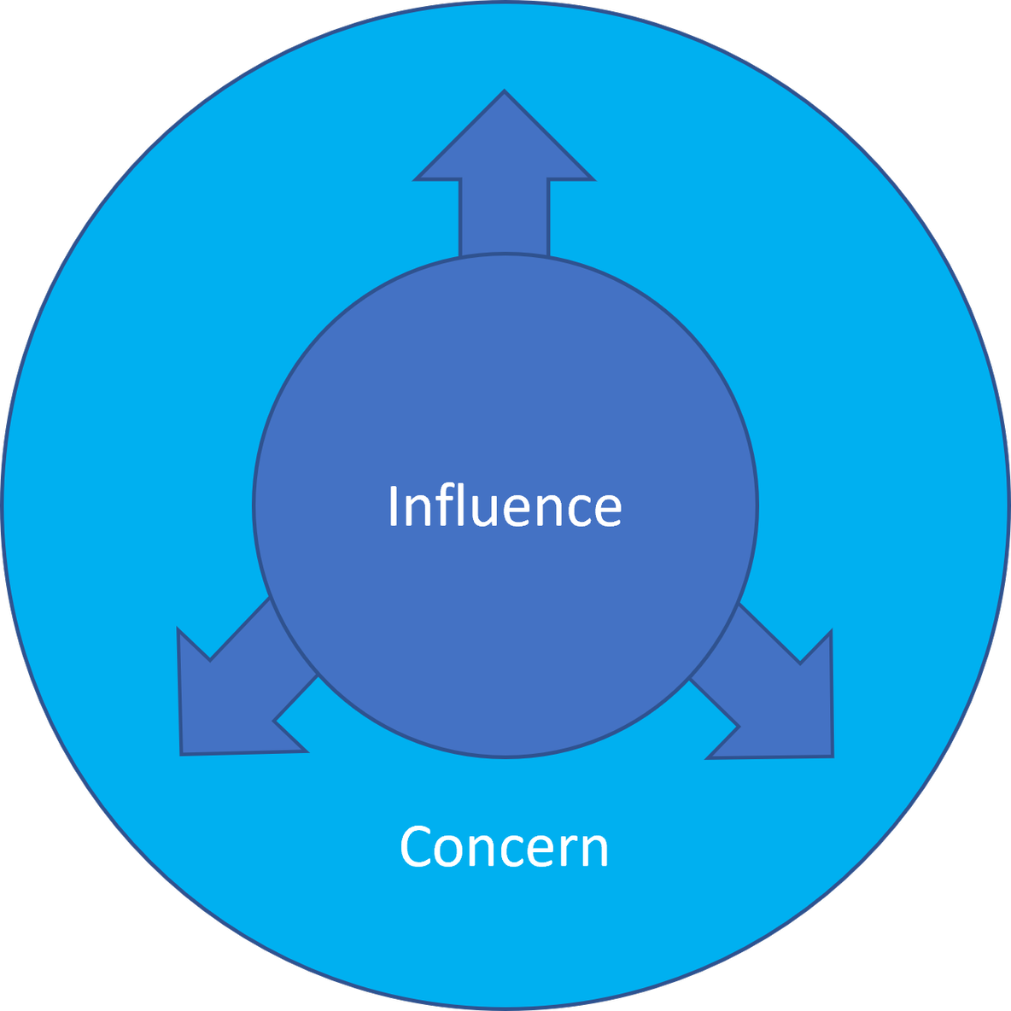
Habit 1 – Be Proactive
Circle of Influence
  One must focus on what one can influence.
  Complaining about something you can’t influence wastes your leadership capital.
  As you focus on your circle of influence, your circle of concern will grow, which will grow your circle of influence.

Slide 15
Be a Transition Figure
Transition Figure
A person who stops the transition of negative behaviors to others.

Slide 16
Theories of Determinism
Reactive people think their behavior is out of their control.
They attribute their behavior to three determinants:
  Genetic – Traits we inherit.
  Psychic – Our Upbringing.
  Environmental – Our Surroundings.
If this is your frame of mind, you are completely hopeless since you can’t control any of these.

Slide 17
The Four Human Endowments
Proactive people exercise the four endowments:
  Self Awareness – Examining thoughts, moods, and behavior.
  Imagination – Visualizing beyond experience and present reality.
  Conscience – Understanding right and wrong and following personal integrity.
  Independent Will – Acting independent of external influence.

Slide 18
Habit 1 – Be Proactive
Proactive
Reactive
You make good choices about responding to a problem or situation.
You are always ready with a calm body and attitude.
You make good choices, so that the right things will happen.
When things don’t go your way, you may be upset, but you stay calm and in control.
You are ready to explode.
You are unprepared for things, and you have a bad attitude.
You do not make good choices, and bad things may happen as a result.

Slide 19
Habit 2 – Begin with the End in Mind
Principle:
  Mental creation precedes physical creation.
Key Paradigms:
  “I can choose my future and create a vision of that future.”
  “I will create results mentally before beginning any activity.”
Key Processes:
  Create and apply personal and organizational mission statements as constitutions for daily living.
  Envision the desired results and important values to guide activities or endeavors.

Slide 20
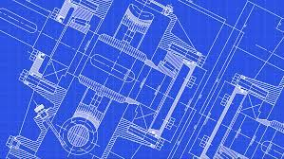
Habit 2 – Begin with the End in Mind
All things are created twice. There is a mental (first) creation and a physical (second) creation. The physical creation follows the mental, just as a building follows a blueprint.

Slide 21
Habit 2 – Begin with the End in Mind
Personal Mission Statement (the mental creation). It focuses on what you want to be and do. It is your plan for success. It reaffirms who you are, focuses on your goals, and moves your ideas into the real world. Your mission statement makes you the leader of your own life. You create your destiny and secure the future you envision.
Mission Statement
A powerful document that expresses your personal sense of purpose and meaning in life; it acts as a governing constitution by which you evaluate decisions and choose behaviors.

Slide 22
Habit 3 – Put First Things First
This key is not to prioritize your schedule, but to schedule your priority.
  Big Rocks
Importance
An activity is important if YOU personally find it valuable, and if it contributes to your mission, values, and high-priority goals.
Urgent
An activity is urgent if YOU or OTHERS feel that it requires immediate attention.

Slide 23
Time Mgmt for Long Term Vision
3 things companies should do well
Focus by level
Executive Level
Innovation
Continuous
Improvement
Manager Level
Maintain Order,
Standardization
Supervisor Level
Operator Level
Technical
Organizational
Cultural

Slide 24
Time Mgmt for Long Term Vision
URGENT
NOT URGENT
Quadrant I: Job Description Related
Crises
Pressing Problems
Deadline-driven projects
Daily, routine tasks
Addresses Today
Quadrant II: Goal Related
Prevention/solving of problems
Planning
Continuous Improvement
Personal Growth & Developing others
Reflection
Opportunities
Addresses Tomorrow
I
M
P
O
R
T
A
N
T
People who stay in this quadrant
get to keep their job
People who stay in this quadrant
get promoted
Quadrant III: Other Duties Related
Interruptions
Some phone calls
Some mail
Some reports
Some meetings
Proximate, pressing matters
Non-specific items
Traditional, Inherited tasks
Quadrant IV: Wasteful Behavior
Trivia
Busy work
Some mail
Some phone calls
Time wasters
Pleasant activities
Fun stuff
Idle time
I
M
P
O
R
T
A
N
T
N
O
T
People who stay in this quadrant
get very, very busy
People who stay in this quadrant
get fired

Slide 25
6 Step Process
Connect to Mission
Review Roles
Identify Goals
Organize Weekly
Exercise Integrity
Evaluate

Slide 26
6 Step Process
Step 1 – Keep your mission statement in front of you so you can connect your goals to that mission.
Step 2 – Look at each role you play (personal and professional) to determine if there are any out of alignment with your mission.
Step 3 – For each role, select goals for that week. These are not typical JDI’s. They are high-leverage important activities.
Step 4 – Schedule the Big Rocks first and let everything else fill in around those activities.
Step 5 – You will be challenged to sacrifice the Big Rocks; you must exercise integrity to prevent that from happening.
Step 6 – Reflect on what went well that week and what you could change in the coming week to be better aligned with your mission.

Slide 27
Habit 4 – Think Win-Win
Principle:
  Effective, long-term relationships require mutual benefit.
Key Paradigms:
  “I see the benefit of others as well as my own.”
  “I get better results in my relationships by cooperating interdependently than by competing independently.”
Key Processes:
  Balance courage and consideration in seeking mutual benefit.
  Persist in looking for win-win outcomes despite past win-lose conditioning.

Slide 28
Habit 4 – Think Win-Win
Six Paradigms of Human Interaction
  Win-Win = Seeks mutual benefit.
  Win-Lose = Focused on self.
  Lose-Win = Quick to please others even if self is harmed.
  Lose-Lose = Put self and others down.
  Win = Self-Centered, not caring if the other person wins or loses.
  Win-Win or No Deal = Highest form of Win-win, willing to walk away if a win-win can’t be found.

Slide 29
Courage / Consideration
High
Show Off
Tactful
Courage (within)
Low
Complainer
Say Nothing
Low
High
Consideration (for others)

Slide 30
Habit 4 – Think Win-Win
Win-Win IS/IS NOT Matrix
IS | IS NOT
A courageous effort | Always being “polite”
The best way to get to independent relationships | Always achievable
A philosophy of human interaction support by an Abundance Mentality. | A manipulative technique
A character (principle) based code for interactions | A personality-based thought pattern.

Slide 31
Habit 4 – Think Win-Win
The Four Dimensions of Win-Win
  Character
    Integrity – People of integrity are true to their feelings, values, and commitments.
    Maturity – Mature people express their ideas and feelings with courage and with consideration for the ideas and feelings of others.
    Abundance Mentality – People with an abundance mentality believe plenty exists for everyone.
  Relationships
    Maintaining a strong Emotional Bank Account.
  Agreements
    See next slide

Slide 32
Win-Win Agreements
Elements of Win-Win Agreements
Desired Results | Clarify the end-in-mind, objects, and outcome.
Guidelines | Specify boundaries and deadlines for accomplishing the results.
Resources | List the human, financial, technical, or organizational resources available for accomplishing the desired results.
Accountability | Identify the standards and methods of measurement for progress and accomplishment.
Consequences | Determine the result(s) of achieving or not achieving win-win.

Slide 33
Habit 4 – Think Win-Win
The Four Dimensions of Win-Win
  Character
    Integrity – People of integrity are true to their feelings, values, and commitments.
    Maturity – Mature people express their ideas and feelings with courage and with consideration for the ideas and feelings of others.
    Abundance Mentality – People with an abundance mentality believe plenty exists for everyone.
  Relationships
    Maintaining a strong Emotional Bank Account.
  Agreements
    Elements of Win-Win Agreements (previous slide)
  Systems and Processes
    Look at current systems and processes to determine if any are incompatible with win-win.
    Create any new systems and processes that can support win-win.

Slide 34
Habit 5 – Seek First to Understand,…
…Then to be understood.
Principles:
  Diagnosis must precede prescription.
  Understanding comes from listening.
Key Paradigms:
  “I assume I don’t fully understand, and I need to listen.”
  “If I listen first to understand, the I will be better understood.”
Key Process:
Use Empathic Listening Skills

Slide 35
Levels of Listening
Ignoring
  Making no effort to list.
Pretend Listening
  Making a belief or giving the appearance that you are listening.
Selective Listening
  Hearing only the parts of the conversation that interest you.
Attentive Listening
  Paying attention and focusing on what the speaker says and comparing that to your own experiences.
Empathic Listening
  Listening and responding with both the heart and the mind to understand the speaker’s words, intent, and feelings.

Slide 36
Autobiographical Responses
Avoid these Autobiographical Responses…
  Advising
    Giving counseling, advice, and solutions to problems.
  Probing
    Asking questions from our frame of reference or agenda.
  Interpreting
    Explaining another’s motives and behaviors based on our own experiences; trying to figure people out.
  Evaluating
    Judge and either agree or disagree.

Slide 37
How we communicate

Slide 38
Five Empathic Listening Responses
Repeat Verbatim the content of the communication – words only, no emotions.
Rephrase Content – summarize their meaning in your own words.
Reflect Feelings – look more deeply and capture feelings in your own words. Look beyond words for body language and tone to indicate feelings.
Rephase Content and Reflect Feelings – express their words and feelings in your own words.
Discern when empathic listening is not necessary or appropriate.

Slide 39
Habit 6 - Synergize
Principle:
  The whole is greater than the sum of the parts.
Key Paradigms:
  “I value differences in others and seek the Third Alternative.”
  “Working together cooperatively takes time but produces better long-term results.”
Key Processes:
  Apply Win-Win (Habit 4) and Empathic Communication (Habit 5) to seek synergistic outcomes, include the Third Alternative (Habit 6).
  Use Synergy ground rules to discover the Third Alternative.

Slide 40
What is Synergy?
Synergy
The whole is greater than the sum of the parts. Synergy takes place when two or more people produce more together than the sum of what they could have produced separately. 1 + 1 = 3

Slide 41
The Process of Synergizing
Synergizing…
IS | IS NOT
Results Oriented, Positive Synergy | A brainstorming free for all
Examining, Exploring, seeking, diverse perspectives openly enough to alter or complete your paradigm | Accepting others’ ideas as full truth
Valuing Differences | Afraid of Differences
Cooperating | Win-lose competition
Having a mutually agreed upon end in mind | Group think (giving in to peer pressure)
Worth the effort and highly effective | Always easy
A process | Only a negotiation technique

Slide 42
The Third Alternative
Third Alternative
SYNERGY
The Result
Problem
or
Opportunity
Synergize
Habits 4,5,&6
The Action and the Process

Slide 43
Habit 7 – Sharpen the Saw
Principle
  Product (results) requires the development of Production Capability (resources)
Key Paradigm
  “I will increase my effectiveness through personal renewal in each of the four dimensions in my life.”
  “I will continually improve.”
Key Processes
  Constantly develop and renew personal resources to create better personal P/PC balance.
  Set and achieve goals for renewal in the physical, mental, spiritual, and social/emotional dimensions.

Slide 44
Four Dimensions of Renewal
What can Sharpen the Saw in the following four areas:
  Physical
    We build physical wellness through proper nutrition, exercise, rest, and stress management.
  Mental
    We increase mental capacity through reading, writing, and reflecting.
  Spiritual
    We develop spiritually through reading inspiring literature, meditating and praying, and spending time in nature.
  Social / Emotional
    We mature socially and emotionally by making consistent, daily deposits in the Emotional Bank account of our key relationships.

Slide 45
Conclusion
The habits, along with the other principles that have been taught, will help you in both your personal and professional lives.
Live these and teach these to others, and your influence will grow.
Questions,
Comments,
or Concerns?

